Slide 1
Theatrical Stage Makeup
Exploring and creating Texture!

Slide 2
Types of Makeup Designs
Realistic
Old Age/ Illness
Bruises, scars, burns & blood
Facial Hair: beards, moustaches, eyebrows, etc..
Fantasy
Animal, Geisha, Tattoos, Fairy, Gore, etc…
Prosthetics
Noses, ears, large wounds, warts, etc….

Slide 3
The Human Face: Highlights & Shadows
Highlights

Slide 4
The Human Face: Highlights & Shadows
Shadows

Slide 5
Highlights & Shadows cont….
Rules of Thumb:
Most highlights have a “partner” shadow
No lines; blend, blend, blend
Always do Highlights first!!!!
The younger & healthier the person the less shadows you use/create.
Use the persons own face as a guide.
Apply with brush, blend with finger!
Consider the CHARACTER!!!!

Slide 6
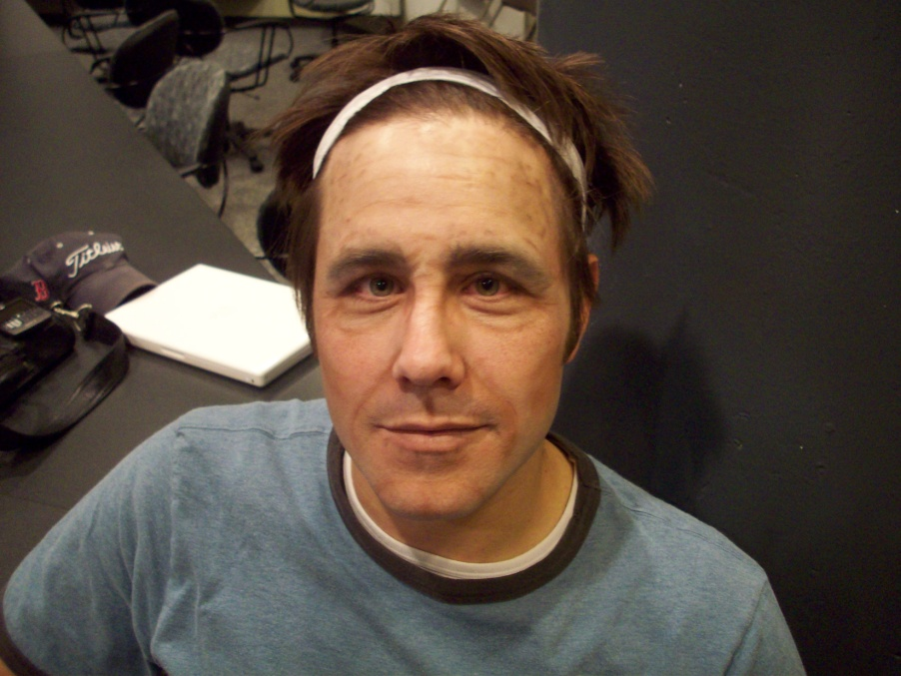
Old Age & Illness
Old Age:
As people age their natural face lines deepen. Wrinkles!!!
Shadows get bigger.
Parts of face discolor, age spots/ liver spots.
Lines are good here!

Slide 9
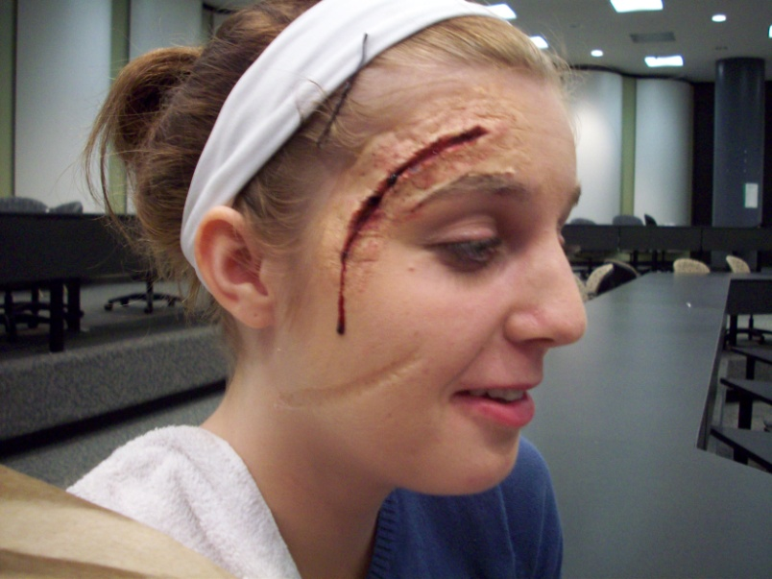
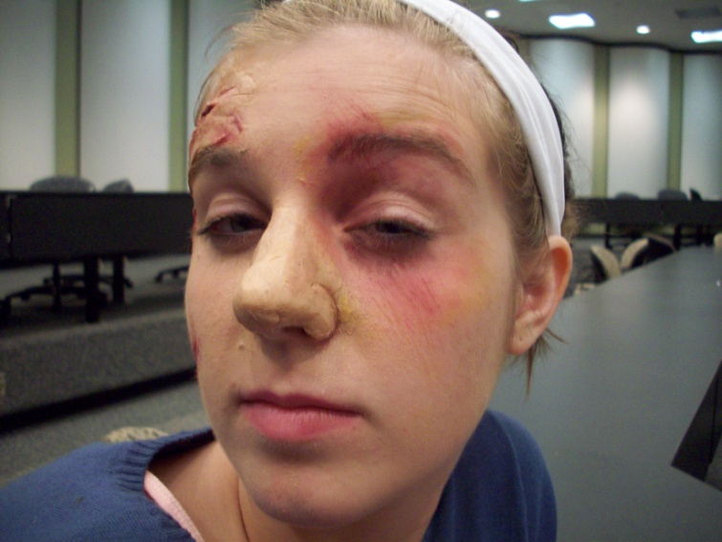
Bruises, scars, burns & blood…..

Slide 10
Bruises, scars, burns & blood…..

Slide 11
Bruises, scars, burns & blood…..
Rules of Thumb:
Remember to always consider point of impact!
Randomness good, uniform bad!
Highlights first!!! Lightest to darkest colors, always!
Fresh looks different than aged.
Blood is always LAST; it doesn’t dry!
Stipple sponges are your friend!!!!

